Slide 1
Course Administration
Required Textbooks:
Morris Mano, “Digital Logic & Computer Design ”, Prentice Hall.
C.H. Roth “Fundamentals of Logic Design”, 7th edition, Cengage Learning
Grading (Theory):
30 midsem + 10 internal + 10 attend + 50 endsem + 25 tuto
Total marks=125
Grading (Practical):
25 Conti. + 25 Final exam = 50 marks

Slide 2
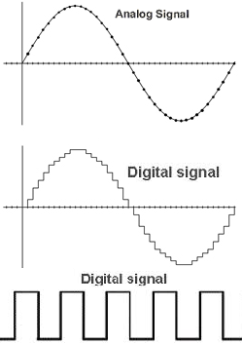
Digital vs Analog
Analog signal: takes any value (and infinite values) in the range, continuous with time (smooth), processed by analog circuit such as RC circuit
Digital signal: takes only finite values, discontinuity between two adjacent values, processed by digital hardware such as logic gates
Present day digital system processes two valued (1 and 0) signal called bit. Why only 1 and 0?
Every information (text, audio, graphics etc.) eventually represented in 1s and 0s in digital system
But, how 1 and 0 are represented?

Slide 3
Digital System
It takes set of discrete information as inputs, processes this discrete information and produces discrete information outputs
What is discrete information ?
Small pieces of data such as alphabets, pixel value, voice sample, video frame etc.
What is meaningful information ?
Collection of discrete information such as text, image, video,
Every information is represented with series of 1s and 0s
Since 1 bit can represent only 2 quantities, we use n bits for representing large amount of information
E.g. 7-bits for ASCII characters, 8/16 bits for each pixel, few KB or MB for a video frame etc.
Digital hardware (Microprocessor, Memory, ASIC etc.) is collection of logic gates

Slide 4
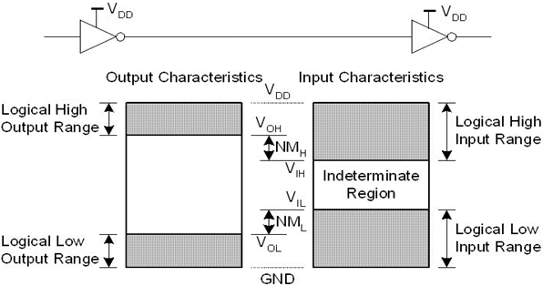
Logic Gate
Types of logic gates
AND, OR, NOT, NAND, NOR, EX-OR, EX-NOR
What is inside the gate?
Electronic circuit (resistor, capacitor, transistor, diode etc. )
Currents and voltages
Electronic Design parameters of logic gate
voltage level for 1 and 0, noise margin (NM), fan out, delay, rise/fall time, current source/sink

Slide 5
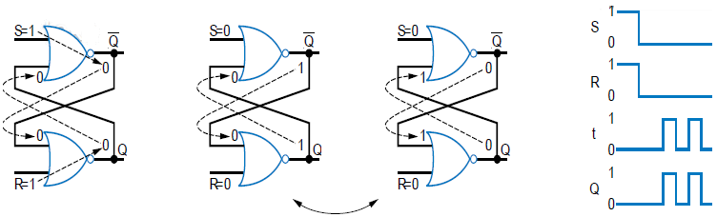
Abnormalities in SR latch
Oscillations:
Other problems:
(i)Metastable output => neither proper 1 nor proper 0 output
(ii)Indeterminate output => valid logic at output but we don’t know which one

Slide 6
Clocked latches
(1) Clocked SR Latch:
Insensitive to S and R inputs when C=0 (maintains previous Q when C=0)
When C becomes 1, the stable S and R value passes through the two AND gates to the SR latch’s S1 R1 inputs.
Indeterminate or Meta stable or oscillation output state when S=R=1
Level-sensitive SR latch
S
S1
C
Q
R
R1
(2) Clocked D Latch:
Maintain previous state when C=0
When C becomes 1, Q follows D input.
No indeterminate state
D latch
D
S
C
Q
R

Slide 7
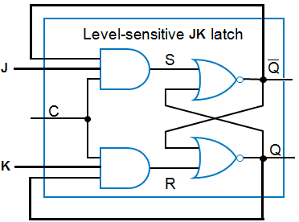

Clocked latches
(3) Clocked JK Latch:
Additional feedback from Q and Q to input side.
J corresponds to S and K corresponds to R
Output is toggled when J=K=1
Output may toggle multiple times –problem
No indeterminate state
(4) Clocked T Latch:
Maintain previous state when C=0
When C becomes 1
If T=0 the Q is same as before
If T=1 the Q toggles
No indeterminate state
Assignment: Construct all latches with NAND gates only

Slide 8
Problem with Level-Sensitive Latches
Clocked latches still have problem
When Clk=1, through how many latches will a signal travel?
Depends on for how long Clk=1
Clk_A -- signal may travel through multiple latches
Clk_B -- signal may travel through fewer latches
Hard to pick Clk that is just the right length
Can we design bit storage that only stores a value on the rising edge of a clock signal?
rising edges
Clk
Courtesy: Digital Design by Frank Vahid

Slide 9
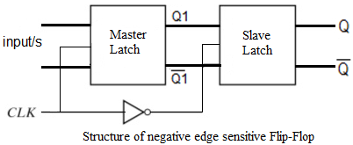
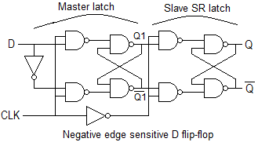
Flip Flop - Master-Slave (edge sensitive)
Convert any Latch to Flip-flop by appending SR latch (slave element) at o/p of master
Master and slave latch are level sensitive but overall operation look edge sensitive
Waveforms ??

Slide 10
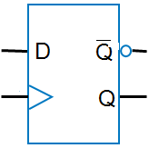
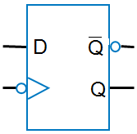
D flip-flop
rising edges
falling edges
Clk
Clk
Symbol for rising-edge
triggered D flip-flop
Symbol for falling-edge
triggered D flip-flop
Draw the waveform of output of latch Q_{L} and flip flop Q_{F} if both Q_{L}=Q_{F}=0 initially.

Slide 11
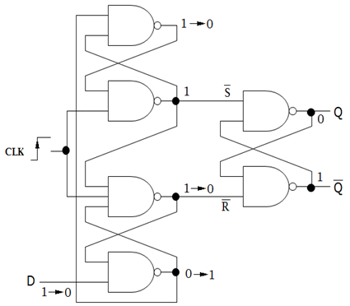
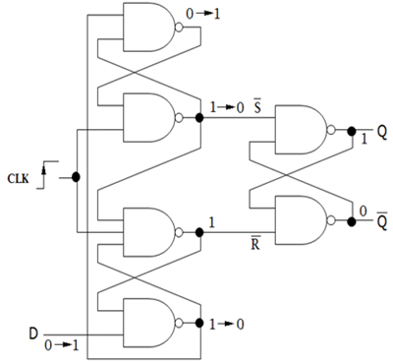
True Positive Edge triggered D ff
(a) Apply D=0 before CLK edge
(b) Apply D=1 before CLK edge
Initially when CLK=0, we have S =R=1
D must be stable before (setup) and after clock (hold) edge for short duration

Slide 12
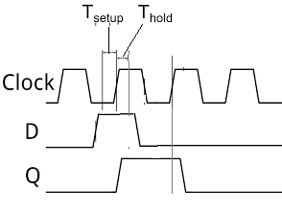
True Positive Edge triggered D ff
Setup time: minimum time for which D must remain stable before the active clock edge for proper triggering
Hold time : minimum time for which D must remain stable before the active clock edge for proper triggering

Slide 13
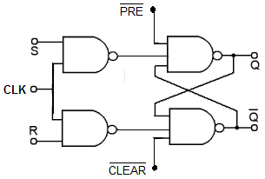
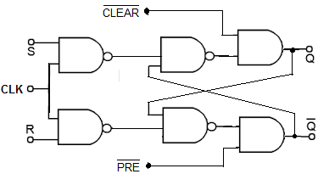
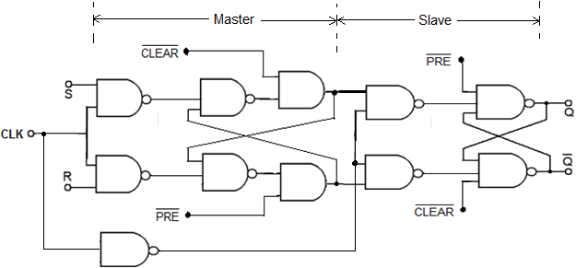
Direct Inputs – Preset and Clear
Direct inputs have proper effect only when CLK=0
Direct inputs have effect at any time
Direct inputs in SR master slave flip flop

Slide 14
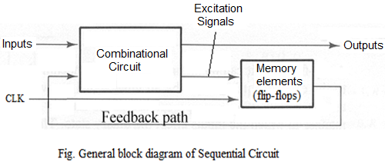
Sequential Circuits
Consist of both combinational logic and memory elements
Outputs => function of Inputs as well as Present state (memory value)
Next State => function of Inputs as well as Present state (memory value)
State is changed in synchronism with clock
Used to implement complex control logic
State Diagram (graph):
Pictorially represents behavior of complex sequential circuits
Complex behavior can be captured in state diagram which is simple to understand

Slide 15
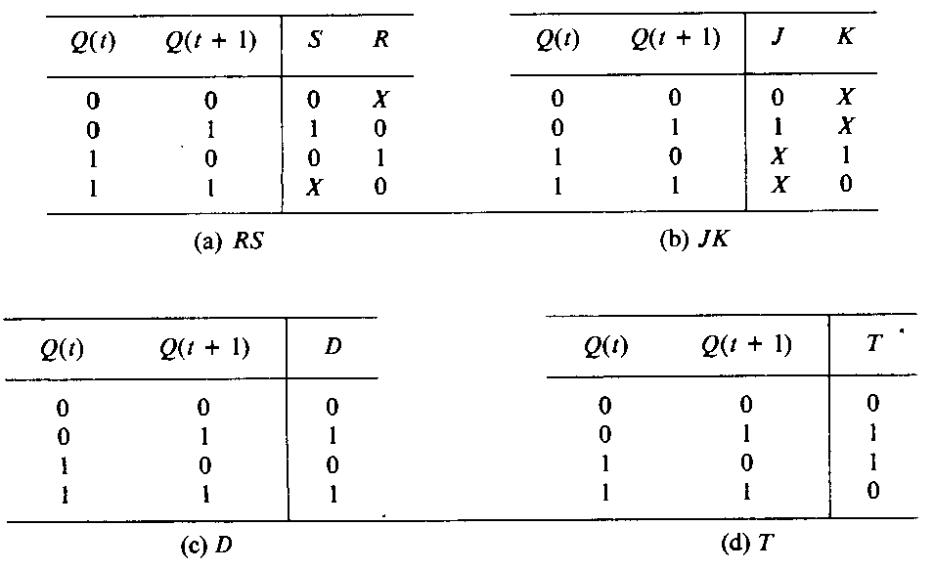
Sequential Circuits
Flip flop excitation tables:
(determines inputs of flip-flop from given transition of Q)

Slide 16
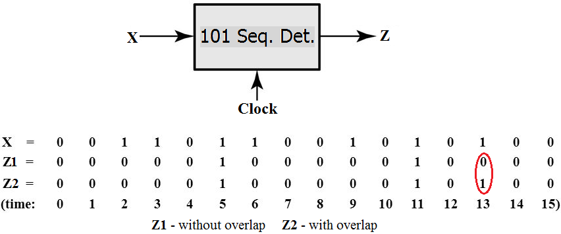
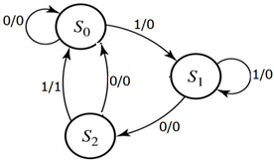
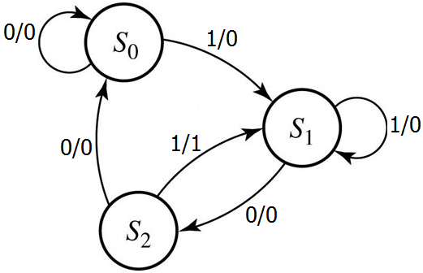
Design Problem – Sequential Circuit
Design logic circuits to detect sequence 101 in input stream and set output HIGH for one clock period (i) without overlap of 101 (ii) with overlap of 101. Use unused states as don’t care.
State diagram without overlap
State diagram with overlap

Slide 17
Design Problem – Sequential Circuit
Two flip-flops are needed => A and B
State assignments => S₀: Q_{A}Q_{B}=00; S₁: Q_{A}Q_{B}=01, S₂: Q_{A}Q_{B}=10
Unused state Q_{A}Q_{B}=11 is considered as don’t care.
(i) Without Overlap: Boolean equation of excitation and output signals
J_{A}=x’Q_{B} , K_{A}=1 J_{B}= x Q_{A}’ , K_{B}= x’ and z= x Q_{A}
(ii) With Overlap: Boolean equation of excitation and output signals
J_{A}=x’Q_{B} , K_{A}=1 J_{B}= x , K_{B}= x’ and z= x Q_{A}

Slide 18
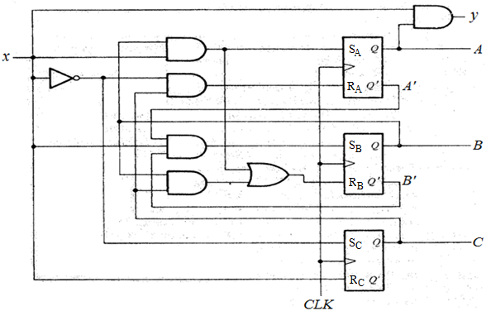
Analysis Problem – Sequential Circuit
Obtain state table and draw state diagram for following logic circuit. Initial state of the circuit is 001. How many unused states are there? Is circuit eventually goes back to valid state from unused states?

Slide 19
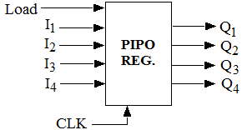
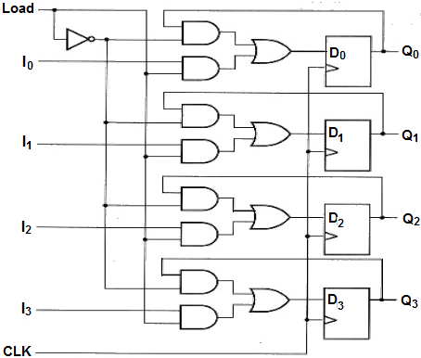
Register with Parallel Load – PIPO Reg.
Ii | Qi | Load | Di
0 | 0/1 | 1 | 0
1 | 0/1 | 1 | 1
0/1 | 0 | 0 | 0
0/1 | 1 | 0 | 1
Input to comb. logic are I_{i}, Load and Q_{i} and output is D_{i}
Di=I_{i} Load + Q_{i} Load
Assignment:
Design loadable PIPO register using JK flip-flops

Slide 20
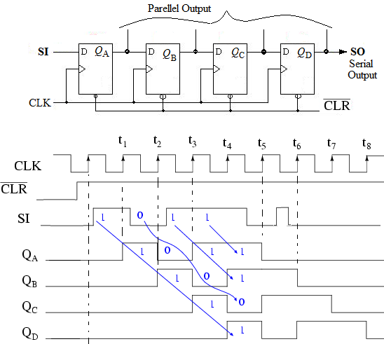
Shift Registers
On rising edge, Q of each FF will acquire value of its D input just before edge
Serial in Serial out (SISO), Serial in Parallel out (SIPO)

Slide 21
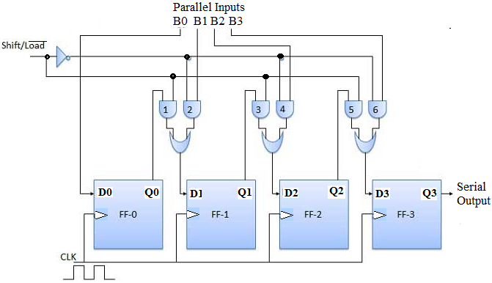
Parallel in Serial out (PISO) register
Shift/load =0 …. Load parallel data in flip-flops
=1 .… Shift data to right
Assignment:
Modify circuit to achieve 0 filled shift?
Draw circuit using direct inputs (PRE and CLEAR) of flip-flops

Slide 22
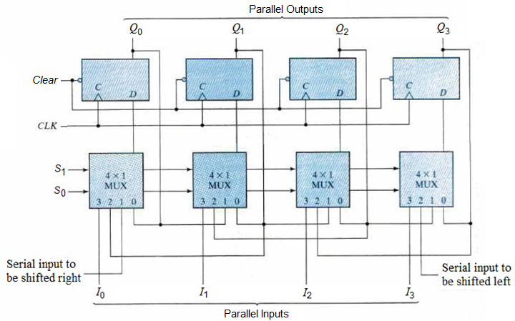
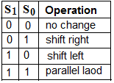
Universal shift register with MUXes
Additional Operations Circular shift (rotate), 0 filled Shift

Slide 23
Circuits with Shift Registers
Example 1: Controlled serial transfer between registers
Example 2: Serial addition using shift registers
Operands (numbers to be added) are available in registers
Bit by bit addition after each shift
Carry needs to be stored (in flip-flop) for next bit addition
Control signal shift controls operation
Serial addition is slow but requires less hardware

Slide 24
Mod-N Synchronous Counter
Mod-N counters: 0, 1, 2, . . ., N-1 and repeat
Design with Sequential design procedure (state diagram N states).
Up-Down Counter:
Has additional control input M
M=0 => Count Up M=1 => Count down
Example: Design Mod-3 Up/Down synchronous counter with control input M. Use unused count state as don’t care.
Obtain two state tables separately: one for UP and one for DOWN counting
Get Expressions for Excitation signals from K-map in terms of Q₀ and Q₁:
J_{0,u} , K_{0,u} , J_{1,u} , K_{1,u} => for UP counting
J_{0,d} , K_{0,d} , J_{1,d} , K_{1,d} => for DOWN counting

Slide 25
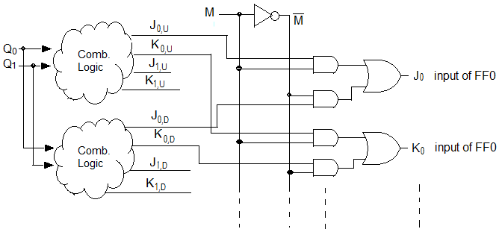
Synchronous Counters
Rough sketch of Logic circuit of Mod-3 up/down counter
Special Counters: Ring Counter, Johnson counter (switch tail ring counter)

Slide 26
Sequence Generator
Design sequence generator to generate sequence 1010100101 and repeat at Q1. Use linear feedback shift register method.
Sequence length S=10
since S < 2^{N} -1 , N=4 (min. flip-flops are required)
Q1 | Q2 | Q3 | Q4 |  | D1
1 | 1 | 0 | 1 |  | 0
0 | 1 | 1 | 0 |  | 1
1 | 0 | 1 | 1 |  | 0
0 | 1 | 0 | 1 |  | 1
1 | 0 | 1 | 0 |  | 0
0 | 1 | 0 | 1 |  | 0
0 | 0 | 1 | 0 |  | 1
1 | 0 | 0 | 1 |  | 0
0 | 1 | 0 | 0 |  | 1
1 | 0 | 1 | 0 |  | 1
Q1 | Q2 | Q3 | Q4 | Q5 |  | D1
1 | 1 | 0 | 1 | 0 |  | 0
0 | 1 | 1 | 0 | 1 |  | 1
1 | 0 | 1 | 1 | 0 |  | 0
0 | 1 | 0 | 1 | 1 |  | 1
1 | 0 | 1 | 0 | 1 |  | 0
0 | 1 | 0 | 1 | 0 |  | 0
0 | 0 | 1 | 0 | 1 |  | 1
1 | 0 | 0 | 1 | 0 |  | 0
0 | 1 | 0 | 0 | 1 |  | 1
1 | 0 | 1 | 0 | 0 |  | 1

Slide 27
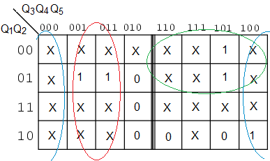
Sequence Generator
It is not possible to produce two different value of D1 for two identical states occurring in sequence. So we add 1 flip-flop and try again.
With 5 flip-flops, we can generate given sequence.
We have 10 valid states out of 32. Remaining states are unused (don’t care)
Draw above sequence generator with Shift register and feed back circuit.

Slide 28
Register Transfer Logic
Describing large digital system with truth tables and state tables would be very difficult
Large digital system can be thought of as consisting of modules such as registers, counters, decoder, multiplexers, arithmetic unit, comparator etc.
We may need high level description method (called Register Transfer statements) to describe digital operations realized with aforementioned modules
RT statement comprises of (i) control function (ii)micro-operations
Control function: list of micro-operations separated by commas
Register Notation:
Declare Registers : A(8), B(8), PC(16)
A(5-8) or A₅₋₈ => upper 4 bits of reg. A
PC (H) => higher byte of reg. PC
A₃ – 3rd bit of register

Slide 29
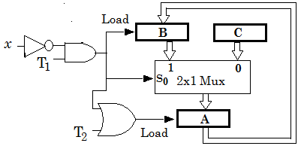
Register Transfer Logic
RTL Description:
(i) e.g. x’T₁: A <- B, B <- A
T₂: A <- C
(ii) T₁: R1 <- R2
T₂: R1 <- R2
T₃ : R1 <- R1
T₄ : R1 <- 0
what is the hardware to implement this? Assume registers of 4-bit size.

Slide 30
Number Presentation
Signed Number Presentation:
(i) Sign Magnitude (ii)Sign 1’s Complement (iii)Sign 2’s Complement
2’s complement
Signed addition and signed subtraction operations
Overflow Condition
Floating Point Representation:
Has two registers=> one for coefficient (mantissa) and one for exponent
Coefficient may be fixed fraction or fixed integer
Mostly normalized representation (no leading zeros in coefficient part) is used

Slide 31
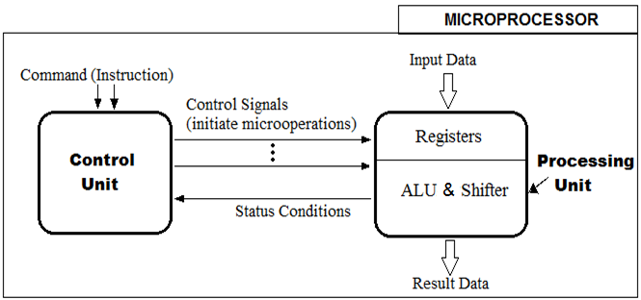
CPU Design
Commands are received from memory (not shown)
Input Data are fetched from memory or available in Registers
Result Data may be either stored in register or in memory

Slide 32
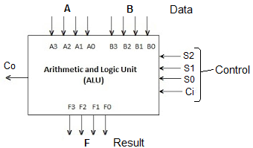
ALU Design
ALU = (Arithmetic + Logic) unit
A, B are 4-bit input data, F is 4-bit result
If S2=0 arithmetic operations else if S2=1 Logic operations
ARITHMETIC UNIT:

Slide 33
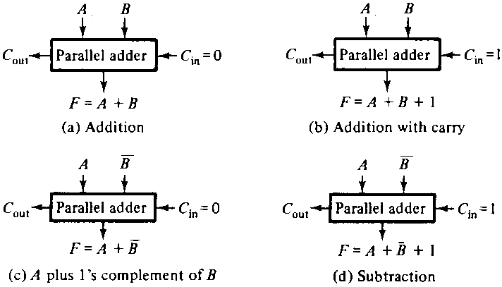
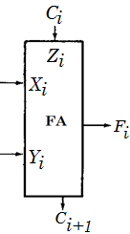
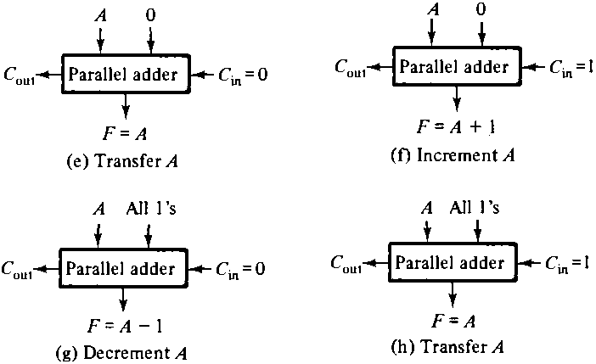


Slide 34
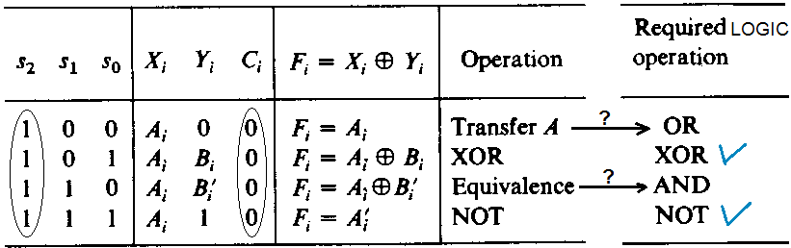
(Arithmetic + Logic) Unit
We make slight change in Arithmetic circuit to incorporate logic operations
(rather than constructing separate Logic unit)
Xi , Yi and Ci are inputs of i^{th} Full Adder circuit
s₂=1 and Ci=0 for all logic operations
XOR, NOT is already available from arithmetic unit. We just need to get OR and AND operation

Slide 35
(Arithmetic + Logic) Unit
To get OR operation=> make X_{i} =A_{i}+ B_{i} only when s₂s₁s₀=100
To get AND operation=> make X_{i} = A_{i}+ B_{i}ʹ only when s₂s₁s₀=110
Otherwise, X_{i} = A_{i}
So general expressions are
X_{i} = A_{i} + s₂ s₁ʹ s₀ʹ B_{i} + s₂ s₁ s₀ʹ B_{i}ʹ
Y_{i} = s₀B_{i} + s₁B_{i}ʹ
Z_{i}= s₂ʹ C_{i}
If s₂=0 above expressions are reduced to that of arithmetic unit

Slide 36
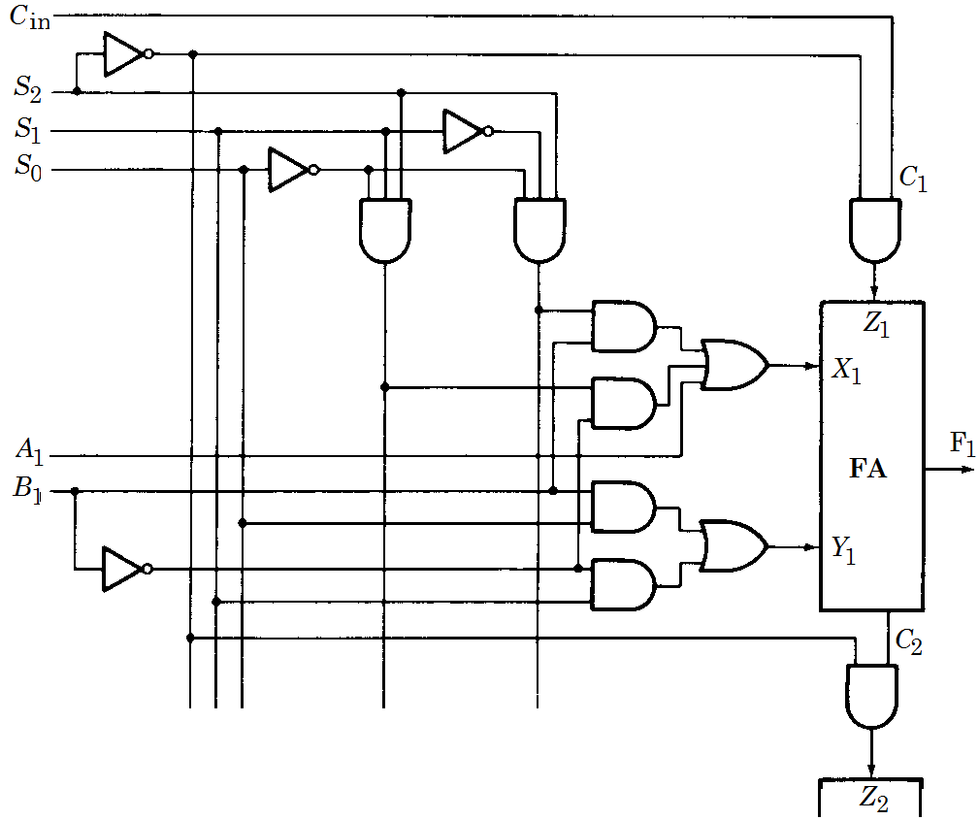
ALU Design
One typical stage (with 1-bit adder) of ALU

Slide 37
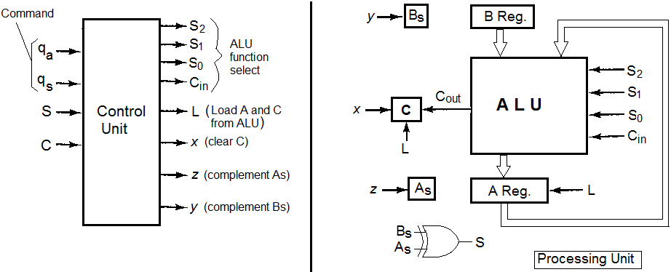
Control Unit Design
Design Control unit for two instructions: (i)signed add (q_{a}=1) (ii)signed subtract (q_{s}=1).
Assume signed data in Signed Magnitude form

